Slide 1
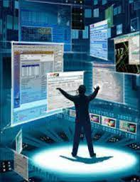
Lesson Tool 4: Interaction Design
After studying this lesson tool, you should:
Know and be able to describe the different interface types that current computer systems have
understand and be able to give examples of specific interaction design techniques, namely:
    low-fidelity prototyping
    high-fidelity prototyping o
    conceptual design including interface metaphor
In this lesson tool, we discuss a small selection of topics that are associated with interaction design. INF3720 – the third-level module on HCI – covers the topic of interaction design in detail. Here we look at the following:
  The different forms that interfaces of interactive systems can take
  Some specific interaction design techniques
  An overview of the evaluation of interactive systems

Slide 2
Interface Types
An Interface: in general its a device or system. An interaction of two or more entities, where information is exchanged.
Based on Preece et al (2019),It is important to consider the interface type to be used at the conceptual design phase
  It is done for both design and practical purposes.
Preece et al (2007, 2014, 2019) list the different types of interfaces.
Command-Based Interfaces ( Cobol, Python, Ms-dos, shell script)
These were mostly commonly used in earlier interfaces.
  User had to respond to a prompt symbol appearing on the computer display to which the system responded to.
  Another characteristic: by pressing a combination of keys (e.g. Alt + Control + Delete).
  Some commands included part of the keyboard such as Enter, Delete and Undo, together with function keys (F5 to display a Power Point presentation).
• This interface been superseded by graphic interfaces with commands such as menus, icons, keyboard shortcuts or pop-ups.
Advantages of Command-Based Interfaces
Users find them easier and faster to use than equivalent menu-based systems when performing certain operations as part of a complex software package.
Been developed for impaired people to enable them to interact in virtual worlds.
Advanced Graphical Interfaces
Graphical user interface (GUI) refers to any interactive system that uses pictures or images to communicate information
  Includes keyboard-based systems that only use graphics to present data.
  Comprises walk-up and use systems where users interact by selecting portions of a graphical image.
Advantages of Advanced Graphical User Interfaces
Visibility:
  Graphical displays can be used to represent complex relationships in data sets that otherwise would not have been apparent – illustrated through bar charts and graphs
Cross-cultural communication:
  Text-based interfaces have severe limitations in the world market.
  Graphical interaction techniques are less limited.
  ISO standards for icons provide an international graphics language
Impact and animation:
  Graphical images have a greater intuitive appeal than text-based interfaces, especially if they are animated.
  The use of such techniques may be beneficial in terms of the quality and quantity of information conveyed.
  It may also be beneficial in improving user reactions to the system itself

Slide 3
Disadvantages of Advanced Graphical User Interfaces (GUI)
Clutter
  Tendency to clutter graphical displays with a vast array of symbols and colours. ▪ Which creates perceptual problems ▪ Making it difficult for users to extract the necessary information.
Ambiguity
  Graphical user interfaces depend on the fact that users are able to associate some semantic information with the image.
Imprecision
  Where GUI cannot convey enough information without textual annotation.
Slow speed
  Graphical presentation techniques are unsuitable if there are : Relatively low-bandwidth communication facilities, or Low-quality presentation devices.
  The performance problems need not relate directly to graphical processing.
    Network delays may delay the presentation of results: Violates the rapid criteria for direct manipulation.
Difficulty finding specific windows
  Too many windows are open - can be difficult for users to find a specific window.
Advanced graphical interfaces
Involve interactive animations, multimedia, virtual environments, and visualisations.
Multimedia
  ▪ Includes graphics, text, video, sound and animations that the user can interact with.
  ▪ It supports quick access to multiple representations of information and is well suited for training, education and entertainment.
  ▪ Problem: users tend to favour animations and video clips and ignore accompanying text and static diagrams.
Virtual reality and virtual environments
  ▪ Graphical simulations that create the illusion that the user is part of the environment - gives users the experience of operating in 3D environments
  ▪ Virtual objects can be very true to life.
  ▪ Users in a virtual environment have either a
    • First-person perspective - see environment through own eyes
    • Third-person perspective - see environment through eyes of an avatar, an artificial representation of a real person

Slide 4
Web-Based Interfaces
Graphical interfaces that are located on servers connected to the internet and are accessed by users through web browsers.
Web design is restricted by the available bandwidth and the associated download time and still relies heavily on the use of text.
Advantages of Web-Based Interfaces
Provides users with access to large volumes of information at the click of a button (Sophisticated search engines such as Google, makes it easy to search for information on specific topics).
  However there’s issues:
    Large amounts of irrelevant information to search through
    Many sources are not trustworthy.
Social Aspect :Allows people to connect quite easily with anybody anywhere in the world.
Speech Interfaces
Allows the user to talk to a system that has the capacity to interpret spoken language. Commonly used in systems that provide specific information or perform a specific transaction
Advantages of Speech Interfaces
Useful to people with disabilities.
Current technology allows more natural-sounding speech than early synthesised speech.
Expands the possibilities technology offers for children who cannot yet read.
Popular speech technology - routing. Companies use automated speech system to enable users to reach one their services with the use of caller-led speech.
Users can articulate queries by using Google Voice or Apple Siri.
Speech-based apps enable people to use them with their mobile devices, which makes it more convenient than any text-based entry.
Disadvantages of Speech Interfaces
Relatively difficult to develop.
May not be adaptable to different accents, voice pitches and speech defects (lisping).
They may misinterpret what the user says.
The voice response may sound unnatural.

Slide 5
Pen, Gesture and Touchscreen Interfaces
Personal digital assistants (PDAs) come with a pen for making on-screen selections, writing notes or making freehand sketches. Objects can also be manipulated by making swiping or stroking gestures.
Pen-based interfaces
  Suitable for large displays
  Personal digital assistants (PDAs)
    ▪ Pen for making on-screen selections, writing notes or making sketches.
    ▪ Objects can also be manipulated by making swiping or stroking gestures.
  Digital ink
    ▪ Convert text written on PDA screen or tablet into digital text.
Gesture-based input
  Involves camera capture and computer vision to detect arm and hand gestures.
  Makes sign language interpreting systems possible.
  Latest systems use sensor technologies to detect touch, bend and speed
Touchscreens
  Allow users to manipulate screen objects with their fingers.
  Function by detecting presence and location of human touch and react on finger tapping, swiping, flicking, pinching and pushing
Advantages of Pen, Gesture and Touchscreen Interfaces
Increase speed and accuracy of input.
Users use natural gestures to interact.
Provide options for users who may have difficulty using the mouse and keyboard.
Pens allows users to easily and quickly annotate existing documents.
Children can write with a stylus on a tablet PC without making too many spelling errors
Disadvantages of Pen, Gesture and Touchscreen Interfaces
The flow of interaction may be interrupted
Incorrect options may accidentally be chosen
Movement and handwriting may be misinterpreted.
On small screens such as a PDA, is that handwritten notes can also be converted and saved as standard typeface text using a pen-based device.

Slide 6
Mobile Interfaces
• Designed for handheld devices (cellphones) that are intended for use on the move.
• The space limitations compel designers to use buttons for multiple purposes
  E.g. single cellphone key can represent up to five characters and is associated with a predefined number of presses of the key.
  Elderly users find this particularly hard to use: Cellphones have been designed for elderly, they have bigger buttons and text, larger displays and big font sizes
A small screen size restricts the font size and the amount of information that can be displayed on the screen
Handheld devices (smartphones and iPads) : differ from PCs and laptops in terms of size, portability and interaction style.
  Early cellphones equipped with hard-wired, small and physical keyboards.
  Most modern smartphones are touch based with virtual pop-up keyboards and are interacted with by finger tapping.
  Tablets and smartphones are also increasingly used in classrooms
Multimodal Interfaces
Different ways of interacting – including touch, sight, sound and speech – are combined so that users can experience or control information in various ways.
Different input or output methods are used simultaneously o E.g. speech and gesture, or eye-gaze and gesture.
Advantages of Multimodal Interfaces
Allow more flexible interaction
Can support users with disabilities or very young users
Disadvantages of Multimodal Interfaces
Input needs to be calibrated for accurate interpretation
They are complex and difficult to implement
Expensive
Shareable Interfaces
• Allow more than one user to interact with the system by providing multiple or simultaneous inputs.

Slide 7
• Tabletop environments detects touch input from multiple users at the same time:
  Use an array of embedded antennae that each transmits a unique signal.
  The users each sit on their own chair or mat which has a receiver installed.
  Through the user’s body, a signal goes from the tabletop to the receiver and tells the computer which antenna was touched.
• E.g. Roomware
  Software that enables a room to interact with people, using Bluetooth and Wi-Fi to share.
  Designed to integrate interactive furniture pieces, walls, table and chairs.
Advantages of Shareable Interfaces
• Provide a large interactional space
• Supports flexible group work and sharing of information
  Enables group members to jointly create content at the same time.
Disadvantages of Shareable Interfaces
• Separating personal and shared workspaces requires specialised hardware and software and correct positioning at the interface.
• Expensive to develop
Tangible Interfaces
• Described by Hornecker and Buur as “a broad range of systems and interfaces relying on embodied interaction, tangible manipulation and physical representation (of data), embeddedness in real space and digitally augmenting physical spaces”.
• Use sensor-based interaction
  Usually RFID tags - stickers, cards or disks that store and retrieve data through a wireless connection with a RFID transceiver
• Physical objects that contain sensors react to user input which can be in the form of speech, touch or the manipulation of the object.
• The effect can take place in the physical object (e.g. toy that reacts to spoken commands) or in some other place (e.g. on a computer screen).
• Used for urban planning and storytelling technologies
Advantages of Tangible Interfaces
Generally good for learning, design and collaboration.
Physical representations of real-life, manipulatable objects enable visualisation of complex plans.
Physical objects and digital representations can be positioned, combined, and explored in dynamic and creative ways, and can be held with both hands.

Slide 8
Suitable for young children
  Can assist with developing sensory awareness and general cognitive development and to help understand abstract concepts
  E.g. PETS (Personal Electronic Teller of Stories) is a tangible storytelling system that allows children to create their own interface – a soft, robotic toy.
More than one person can explore the interface together and objects can be placed on top of, beside and inside each other.
  Encourage different ways of representing and exploring a problems space.
Disadvantages of Tangible Interfaces
• Development costs
• Inaccurate mapping between actions and their effects
• Incorrect placement of digital feedback
Augmented and Mixed-Reality Interfaces
Virtual representations = superimposed on physical devices and objects
Mixed-reality environment = views of the real world are combined with views of a virtual environment.
Used for medical applications – such as
  ▪ A scanned image of organs or unborn baby is projected onto body of patient to help doctors to see what goes on inside someone’s body.
  ▪ Aviation - show the real plane landing, taking off, and taxiing, and for poor weather conditions
Advantages Augmented and Mixed-Reality Interfaces
• Enhance perception of the real world & support training and education (simulators).
• Everyday graphical representations such as maps, can be overlaid with additional dynamic information, such as with:
  Fish finders
  AR apps can guide a person holding a phone while walking.
Disadvantages Augmented and Mixed-Reality Interfaces
• The added information could become distracting
• Users may have difficulty to distinguish between the real and the virtual world
• Expensive systems
Wearable Interfaces As the name suggests, wearable are electronic devices which you can wear on you like an accessory or apparel. (e.g smart watches).
Involve input and output devices that are integrated with normal apparel such as headgear or goggles.

Slide 9
Advantages of Wearable Interfaces
• Mobile and less restrictive than desk-based technologies or even mobile technologies.
• Create a sense of realism
• Provide immediate feedback
  Helpful in the detection of medical conditions
• E.g. A sensor built into running shoes so their progress during a race can be monitored
Disadvantages of Wearable Interfaces
• Uncomfortable because of their size and weight
• Restricted battery life
Multimedia Interfaces
• Implies the use of a combination of different media within a single interface, namely graphics, text, video, sound and animation.
• Link the different combinations of media with other forms of interactivity. o E.g. users can click on hotspot or link in an image or text that leads to another part of programme where user might find a video or animation.
• Combining media and interactivity provides better ways of presenting information and of doing it in different formats.
Designed to be used with games that encourage users to explore different parts of a game or story by clicking on different parts of the screen.
Developed for mostly training, educational and entertainment purposes.
Hands-on interactive simulations have also been incorporated as part of multimedia learning environments.
Advantages of Multimedia Interface
Ability to facilitate rapid access to multiple representations of information.
  Work well in digital libraries because they provide an assortment of audio and visual materials on a certain topic.
Virtual Reality (VR)
• Uses computer-generated graphical simulations to create the illusion of participation in a synthetic environment.
• Refers to the experience of interacting with an artificial environment.
• Widely used in retail and property sectors.

Slide 10
Disadvantages of VR:
• Users found head-mounted displays difficult to use and uncomfortable to wear.
• Caused motion sickness
• Too expensive.
However, VR headsets are now more affordable and more accurate head tracking allows developers to create compelling games, movies, and virtual environments.
Advantage of Virtual Reality
• Provide opportunities for new kinds of immersive experience by enabling users to interact with objects and navigation in 3D space.
  3D software toolkits make the programming of a virtual environment easier.
• High fidelity of simulations of the real world compared to other forms of graphic interfaces such as multimedia.
Robotic and Drone Interfaces
Enable users to move and steer a remote robot.
Robots
  Computational devices that have the physical appearance and behaviour of humans or animals.
  Can go into small or dangerous places or do manual repetitive tasks.
  Domestic robots can help in the house, and assist the disabled / elderly to pick up objects from the floor or to cook meals.
  Pet-like robots - developed to host events or act as a companion
Drones
  Unmanned aircraft controlled remotely
  Have become more affordable, accessible and easier to fly.
  Used:
    ▪ Entertainment industry to carry drinks and food around
    ▪ Agriculture to fly over farm lands and vineyards to collect data,
  Can fly very low and stream photos to a ground station where images are stitched onto maps and then used to assist decision making.
Information Visualisation and Dashboard Interfaces
Information visualisation (infoviz) : Computer- generated graphics of complex data which are interactive and dynamic.

Slide 11
Examples
Tree maps to visualise file systems to enable users to understand why they are running out of disk space or realise how much space different applications take up
Represent changes in stock prices and shares over time
Aim of information visualisation interfaces:
• Amplify human cognition by enabling users to see patterns, trends and anomalies in the visualisation and to gain insight from it.
• Facilitate discovery, decision-making and the explanation of phenomena.
Dashboards
• Popular form of visualising information
• Show screenshots of data updated over periods of time to be read at a glance.
• More interactive and slices of data depict the current state of a system or process.
Disadvantage of dashboards
• Poor visual design of dashboards by software vendors.
Consumer Electronics and Appliances – includes:
• Machines for everyday use in public, at home or in a car.
  Washing machines, microwaves, dish washers, DVD players, navigation systems.
• Personal devices
  MP3 players, digital clocks and digital cameras.
What does the use of consumer electronic appliances have in common with personal devices?
Users try to get something done in the shortest period of time. E.g. switching on washing machine, watching a TV programme, buying a ticket, setting the time, or taking a snapshot.
Consumers are unlikely to read a manual to see how they are supposed to use the appliance.
INTERACTION DESIGN TECHNIQUES
The iterative interaction design process involves:
Identify users’ needs and requirements
Develop alternative designs according to those requirements
Build interactive versions (prototypes) of those designs
Evaluate the users’ experience of the product.

Slide 12
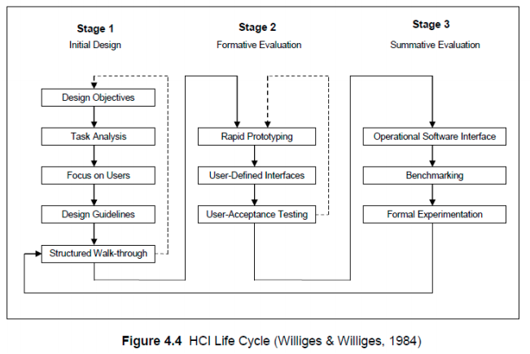
Good interaction design is the philosophy of user-centred design, which means that users are involved throughout the development.
Prototypes
Limited representation of a design that allows users to interact and to explore usability.
Can range from a simple, paper-based storyboard of the interface screens to a computer-based, functionally reduced version of the actual system.
Advanced into 3D printing technology.
Prototypes have several functions:
Provide a way to test different design ideas, especially during the evaluation of ideas.
Act as a communication medium within the design team
  ▪ Members test their ideas on the prototype and the team discusses their ideas.
Act as a communication medium between designers and users or clients.
  ▪ Designers can explain to users and clients their own understanding of what the system should look like and what it should be able to do and get feedback.
Help designers to choose between alternative designs.
Williges and Williges
• Classic model of software development - interface design drives overall design process.
• Idea = by identifying user requirements early on in the software development process, code generation and modification effort will be reduced.

Slide 13
Low-Fidelity Prototypes
A cheap mock-up of a system.
Does not use the material that the final product will be made of, and it may not even look like the intended system.
Conveys basic components and functionality of the system and can fulfil the purpose.
A prototype will use materials such as paper and cardboard rather than electronic screen material with limited functionality, or only represent the functions but not perform any.
Advantages of Low-Fidelity Prototypes
  Cheap and simple, and can be produced or adapted very quickly
  Useful if designers have just begun and still need to explore different ideas.
Low-fidelity prototypes are not meant to become part of the real system – they are usually thrown away when they have served their purpose (or are kept for sentimental reasons).
Examples of low-fidelity prototyping are:
• Storyboards
  A series of simple images representing the screens show how the user will progress through an application.
  Used to demonstrate to consumers how they need to navigate through a task.
• Sketching o More detailed sketches of the interface, including what the icons will look like.
  Requires better drawing abilities than storyboards.
• Index cards
  Each card represents a screen or an element of a task, and the user can be taken through different sequences of these.
• Wizard of Oz
  A basic software-based prototype, but it still lacks functionality.
  User uses it as if it had all the functionality - feedback provided by someone in a different room at a computer connected to the user’s computer.
High-Fidelity Prototypes
Resemble the final system
• Usually use same materials that would be used in the final product.

Slide 14
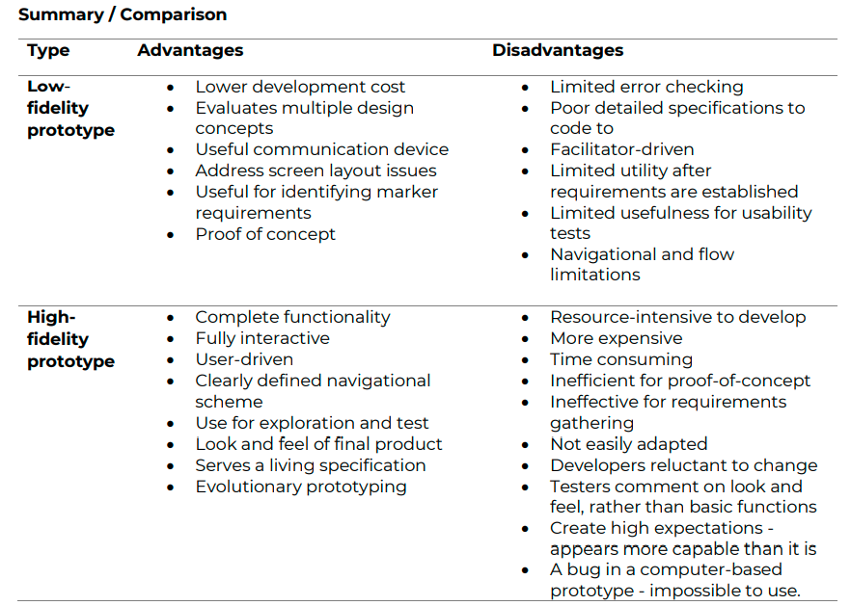
• Developed by modifying and integrating existing components – hardware and software
  Requires software tools and programming skills.
  Windows programming languages, like Delphi and Visual Basic, are powerful prototyping tools and can be used by someone with basic programming skills.
• Can gradually develop into the final product = evolutionary prototyping
Conceptual Design
• Involves turning users’ needs and requirements into a conceptual
• Conceptual model, according to Preece:
  A “high-level description of how a system is organised and operates”
• Described by Shneiderman as:
  “transforming requirements into a conceptual model.”
• It is not a description of the interface but it gives an idea of what users can do with a system and what concepts they need to be familiar with in order to use it.
  Prototypes is a way of getting the conceptual model of the intended system right.
Principles by Preece to follow when doing the conceptual design:
• Keep an open mind but always think of the users and their context.
• Discuss the design ideas with all stakeholders as often as possible.
• Use low-fidelity prototyping to get quick feedback.
• Iterate and repeat the above until have the correct conceptual design.

Slide 15
The conceptual-design process requires the designer to determine:
  How the functions to be performed will be divided between the system and the users
  How these functions relate to each other
  What information should be available to perform these functions.
With the conceptual model, it is important to understand how people will interact with the product - Interaction with product requirements will emerge from functionality requirements.
Preece identified a variety of issues which concept designers should understand. They relate to how to interact with a product:
  Who will the user be?
  What kind of interaction will be used?
  What kind of interface will be used?
  Terminology, metaphors, and the application domain need to be understood.
Two important factors in conceptual design are interface metaphors and the interface type.
Interface Metaphors
• Important component of any conceptual model.
• Provides a structure that is similar to some aspects of a familiar entity, but it also has its own behaviours and properties.
• Used to explain something that is hard to grasp by comparing it with something that is familiar and easy to grasp.
• E.g. Windows desktop–computer screen is like a desktop and folders and applications are like things we could in real-life have on top of a desk.
• Metaphor chosen for an interface must fit the task and be suitable for intended users.
  Metaphors that appeal to adults may have no meaning for children.
• Can also be used to turn something that is potentially boring into an engaging experience – E.g. learning multiplication - Timez Attack children’s game
• Purpose of a metaphor is to provide a familiar structure for interaction.

Slide 16
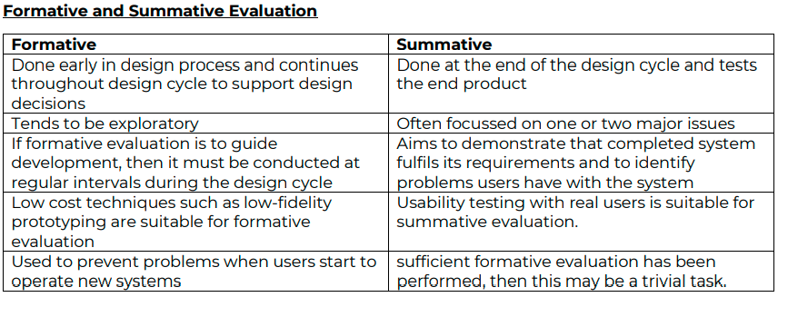
Interface Types
• When doing the conceptual design:
  • Designers should not be influenced by a specific predetermined interface type.
    ▪ May stifle design process and cause good solutions to be overlooked.
  • Reinterpret an initial conceptual design for all the different types of interfaces and consider the effect that the change in interface type has on the design.
Preece identified 4 different types of interaction:
Instructing
Conversing
Manipulating and
Exploring
These interaction types will depend on:
• The application domain
• The kind of product being developed
• If it would be suited to the current design.
Any system comes with constraints on the type of interface that can be used.
Evaluation of interactive systems - key aspect of HCI (Interaction design in particular)
• Evaluation refers to validation of an interactive system against HCI requirements.
• Any design should be assessed and all systems should be tested to ensure that they meet the user requirements.
• Not a single phase that comes at end of the design process, but activity repeated throughout design process to provide feedback on the design right from the beginning.
3 main goals of evaluation
To assess the extent of the system’s functionality
To assess the effect of the interface on the user
To identify specific problems with the system
Dix and Williges and Williges (1984) distinguish between formative and summative evaluation.

Slide 17
We can summarise how evaluation fits into the design life cycle as follows:
• During the early design stages, evaluation is done to:
  Predict the usability of a product or an aspect of it
  Check if design team understands user requirements by evaluating how an existing system is being used in the field
  Test ideas quickly and informally as part of envisioning a possible design
• Later in the design process, the focus shifts to:
  Identifying user difficulties so the product can be fine-tuned to meet their needs
  Improving an upgrade of the product
Evaluation plays a major role in interaction design. Without some form of evaluation, it is impossible to know if the system satisfies the needs of the users and to determine how well it fits the physical, social and organisational context in which it will be used.
How to Evaluate
• Can be done in laboratories or in the real-life environment where system will be used
• Evaluation methods and the evaluation setting are closely linked.
3 Main Evaluation Approaches
Usability Testing
• Usability laboratories with audio & video recording facilities, and specialised hardware & software to record and analyse users behaviour when using a system.
  ▪ Gives evaluator control over conditions of the study but removes the natural context which may be important in the use of the system.
• During usability testing,
▪ Typical users perform selected tasks while their actions are recorded.
▪ The evaluator:
  • Analyses data collected to judge performance
  • Identifies errors
  • Explains user behaviour.
  • Should not directly interact with user in a way that can skew results.
  ▪ Idea = derive some measurable observations that can be analysed using statistical techniques - requires specialist skills in HCI.
• Usually supplemented with interviews and satisfaction questionnaires.

Slide 18
Field Studies
• Evaluation done in natural settings / real environment – difficult to set up.
• Aim is to understand what users do naturally and to examine how the technology affects them in the real-life environment.
• The evaluator can be an:
  ▪ Outsider that observes and records what is happening, or ▪ Insider or participant to experience impact of the technology first-hand.
• Subjects can be influenced by presence of researchers in working environment.
• Avoids irritation that can be created by use of interviews and questionnaires.
• Requires a considerable amount of skill
Analytical Evaluation
A heuristic evaluation that involves experts who use heuristics and knowledge of typical users to predict usability problems, OR,
Walk-throughs where experts “walk through” typical tasks.
Users need not be present, and prototypes can be used in the evaluation.
Popular heuristics were designed for screen-based applications and are inappropriate for technologies like mobiles and computerised toys.
Other evaluation techniques that can be combined with 3 main methods, or performed as part of these methods are cooperative and scenario-based evaluation techniques.
Cooperative Evaluation Techniques
▪ Useful during the formative stages of design.
▪ Less hypothesis-driven & good way of getting user feedback on partial implementations.
▪ The approach is extremely simple:
  Evaluators sit with users while they work their way through a series of tasks.
    ▪ Occur in the working context or a quiet room away from shop floor.
  Designers use low-fidelity prototyping or partial implementations of final interface.
  Evaluators free to talk to users as they perform their tasks, but not distract them.
  If user requires help, designer should offer it and note down problems context
  Main point is that subjects should vocalise thoughts as they work with the system.
  Records of observations must be kept for analysis - notes or record sessions.
Advantages
▪ Low-cost technique that is very effective for providing rough-and-ready feedback. ▪ Users feel directly involved in the development process - Contrast with experimental approaches - users feel constrained by rules of testing

Slide 19
Disadvantages:
Provides qualitative feedback and not measurable results.
  Process produces opinions and not numbers.
Ineffective if designers are unaware of the political and other pressures that might bias a user’s responses (influence them either positively or negatively).
Scenario-Based Evaluation
Scenarios are informal narrative descriptions of possible situations.
In interface design, it is a sample trace of interaction.
Forces designers to identify key tasks in the requirements gathering stage of design
As design progresses, these tasks are used to form a case book (containing standard tests) against which any potential interface is assessed.
Evaluation continues by showing the user what it would be like to complete these standard tests using each of the interfaces.
Typically, users are asked to comment on the proposed design in an informal way.
  Done by presenting them with sketches or simple mock-ups of the final system.
Advantages Scenario-Based Evaluation
Different design options can be evaluated against a common test suite.
  Users can provide focussed feedback about system to perform critical tasks.
  Direct comparisons can be made between the alternative designs.
Scenarios help to identify and test design ideas early on.
Disadvantages Scenario-Based Evaluation
Can focus designers’ attention upon a small selection of tasks.
  Some functionality remains untested, and users become familiar with small set of examples.
Difficult to derive measurable data from the use of scenario-based techniques.
  Must be used in conjunction with other approaches such as usability testing

Slide 20
Query techniques
The two main types of query techniques are interviews and questionnaires.
Interviews
Involves asking users questions about their experiences with the system under evaluation. For an interview to be effective:
Interviewer must plan it carefully by preparing specific questions or making a list of topics to address.
  Help to focus interview and to keep issues discussed with different users consistent.
Should not be overly structured so interviewer can easily adapt questioning to suit users.
Structured interviews are easier to conduct and analyse than flexible interviews.
  May miss important details relating to the user’s experience which a more flexible interview would have picked up.
A good compromise is a semi-structured interview which is based on leading questions but has the flexibility to investigate promising or unanticipated directions.
Advantages Interviews
Evaluator can:
  Vary the level of questioning to suit the context
  Probe user for more information on relevant issues which arise spontaneously
Questionnaires
Consists of fixed questions relating to interaction with the system being evaluated.
When used for the purpose of evaluation, users complete the questionnaire after completing a given task or set of tasks.
Less flexible than interviews, but has several advantages:
Advantages Questionnaires
Larger number of users can be included in the evaluation
  Less time-consuming
  Less Labour intensive
Results can be analysed more rigorously
Different styles of questions can be used
  Open-ended questions - allows user to freely give his or her opinion
  Closed questions - multiple-choice or ranked questions.
Can be completed in
  Fixed sessions or ,
  Administered independent of time and place, and without an evaluator

Slide 21
Heuristic Evaluation
Developed by Jakob Nielsen and his colleagues (Nielsen 1994).
User interface design experts evaluate the user interface according to usability principles known as heuristics.
The process of heuristic evaluation involves 3 steps:
Briefing: Experts are told what to do.
Evaluation: Each expert spends a few hours taking at least two passes through the interface, using the heuristics to identify problems.
Debriefing: Experts meet to discuss their evaluations, prioritize problems and suggest solutions.
Advantage
Fewer practical and ethical issues to take into account as users are not involved.
Disadvantage
Experts often identify problems that aren’t really problems. o Suggests that
Heuristic evaluation should be used along with other techniques
Several evaluators should take part in the evaluation
List of Nielsen’s evaluation heuristics formulated as questions:
How good is the visibility of system status?
Is there a clear match between the system and the real world?
Do users have control when needed and are they free to explore when necessary?
Does the user interface display consistency and adherence to standards?
Does interface help users to recognise and diagnose errors, and to recover from them?
How good is the error prevention?
Does the interface rely on recognition rather than on recall?
How flexible and efficient is it to use?
How good is the interface in terms of aesthetics and minimalist (clear & simple) design?
Is adequate help and documentation available

